Slide 1
QUILT STORIES
Patricia Ciricillo
Quilts photographed by Greg Schaler

Slide 2
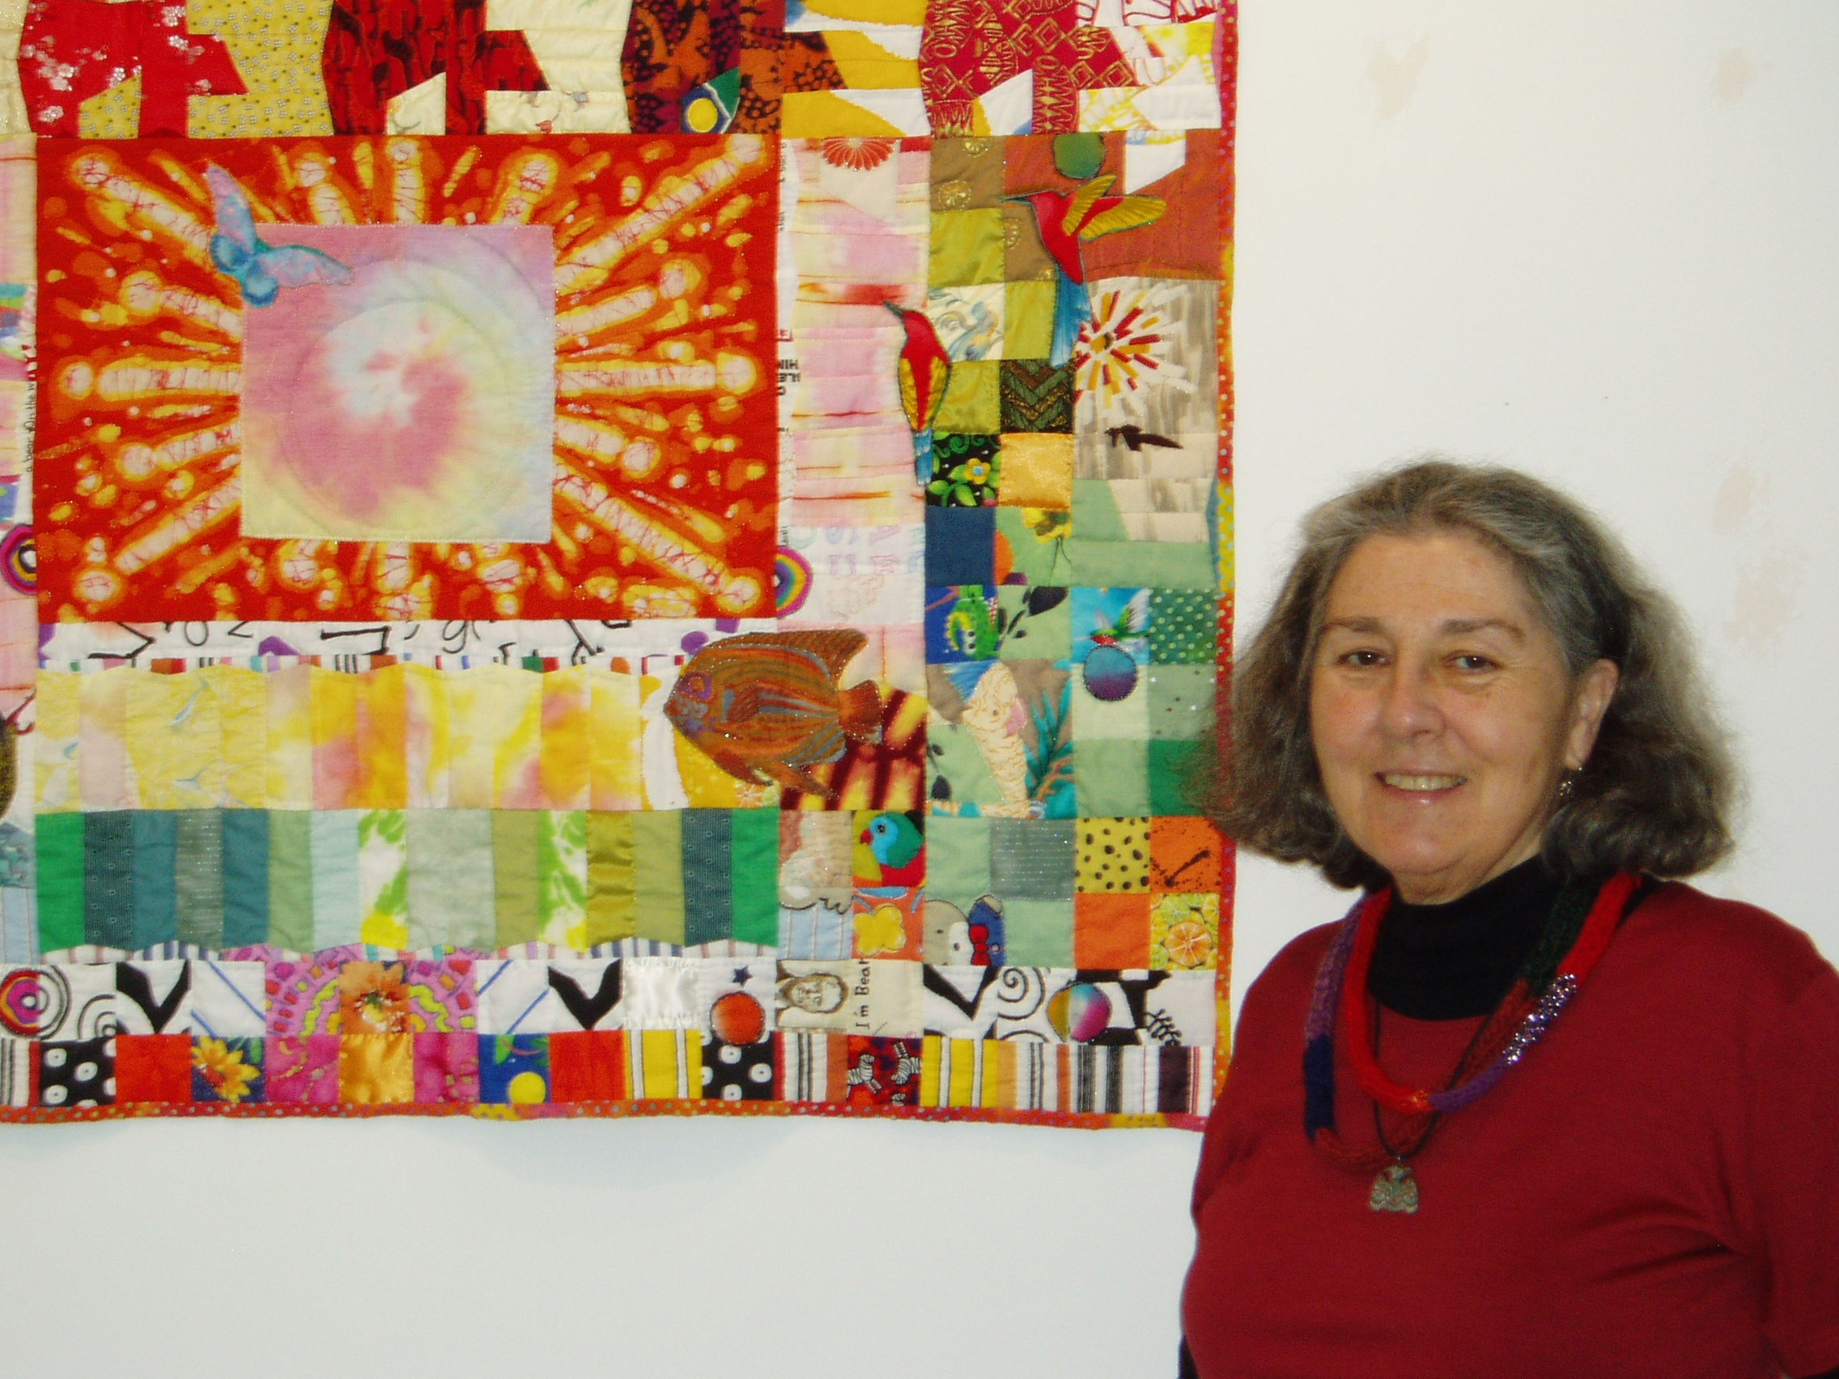

Slide 3
“My quilts include traditional patchwork patterns and original designs. I have experimented with geometric designs as well as landscape or architectural scenes. My primary inspiration has been the fabric itself: First, traditional quilting materials and designer cottons; later supplemented by ethnic fabrics from around the world; still other fabrics, I paint and dye myself. Always my fabrics are enhanced by gifts from and exchanges with other fiber artists. My work tends to have an abundance of symbolic content. The quilts are a kind of journal for me, incorporating reminiscences and ongoing commentary.”
Patricia Yolande Ciricillo

Slide 4
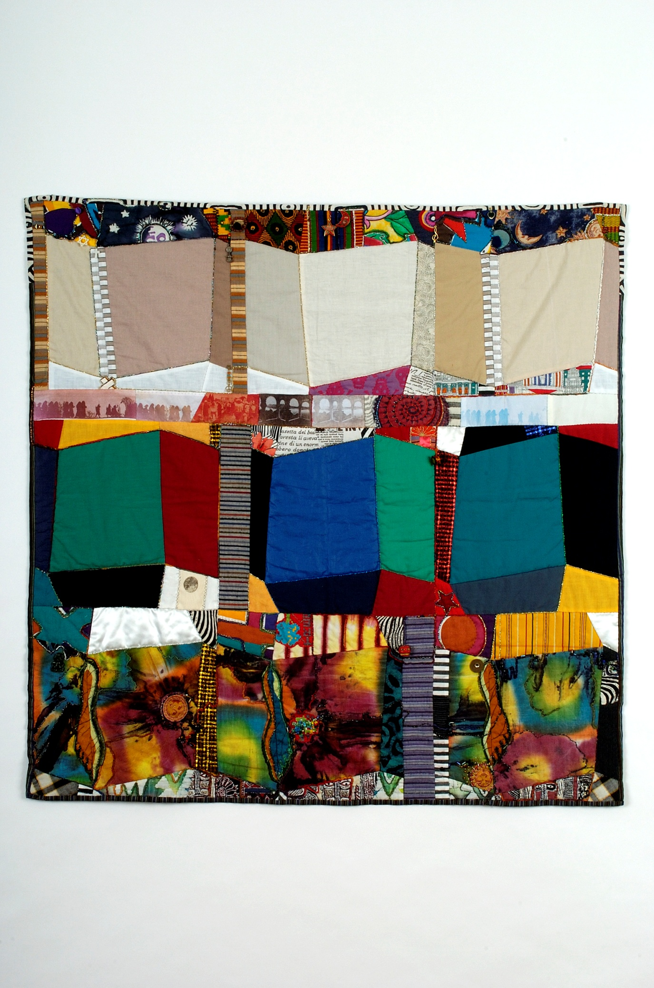
Malcolm (Waves 12)

Slide 5
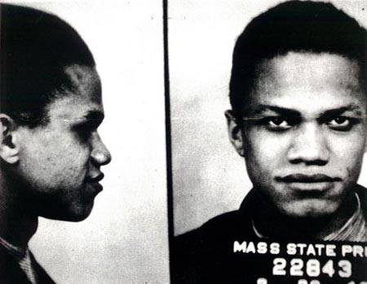
CRIMINAL LAW:
Violence and confusion of Malcolm’s youth:
Wave pattern with blood reds and confusion and unconscious gods below

Slide 6
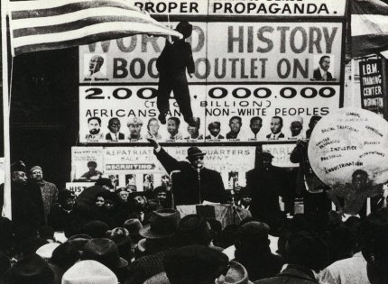
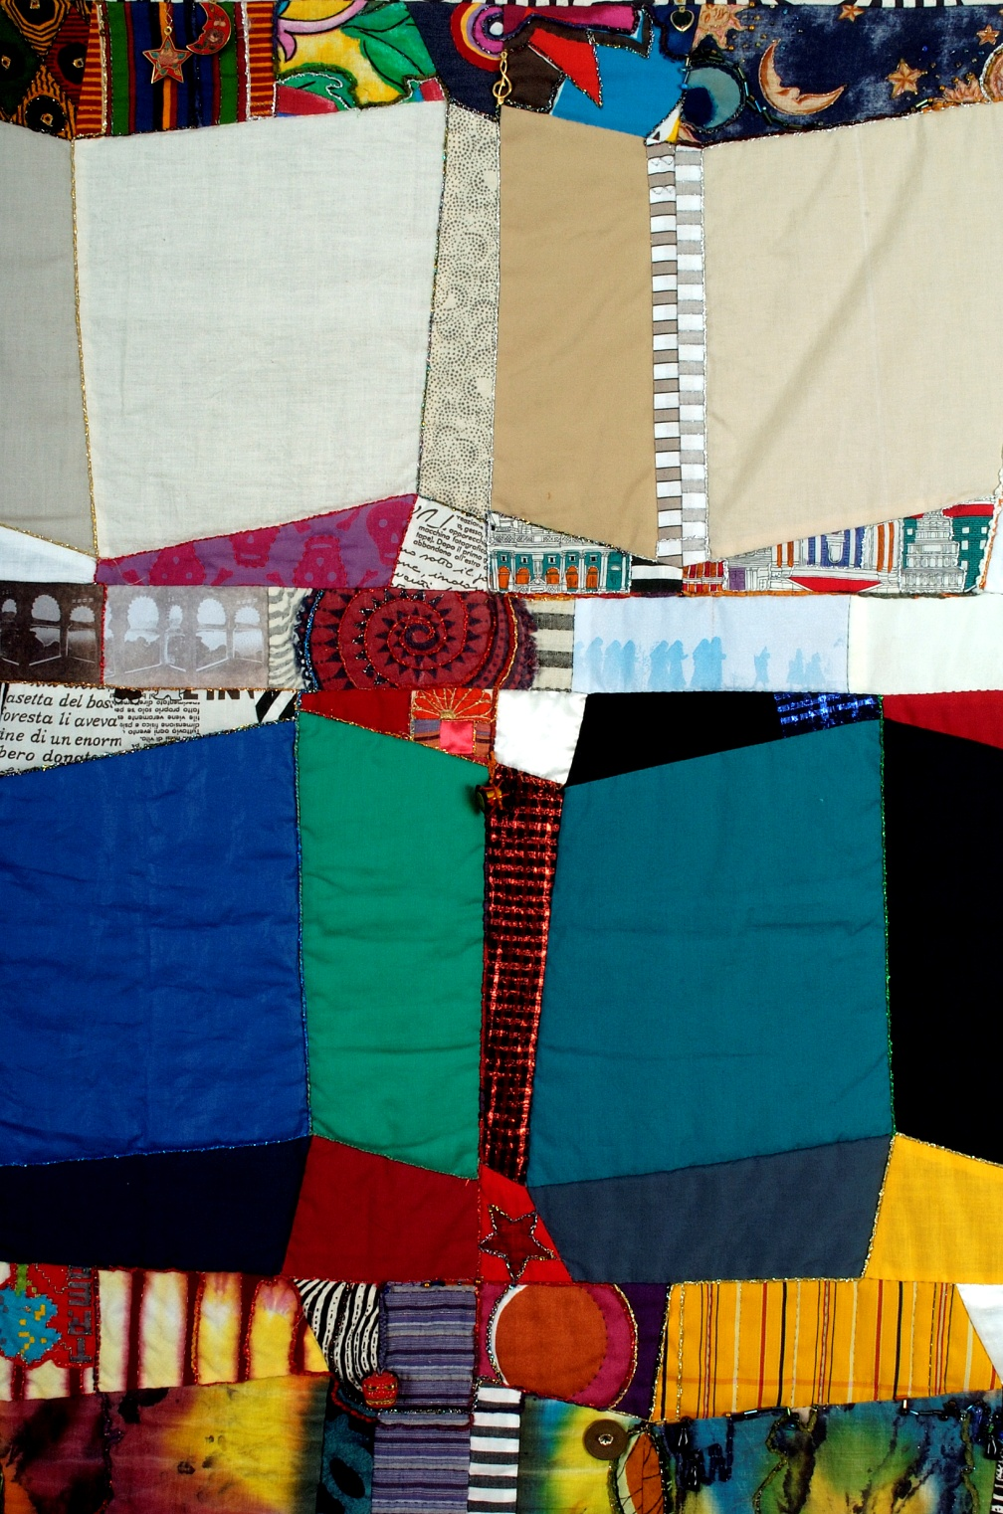
RACE: Black Muslim leader – plain and sharp contrast between races and good and evil:
Solid color wave block with black and white set off surroundings
Notes:
Race and Law

Slide 7
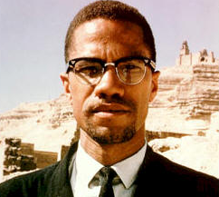
RELIGION: Conversion to Universal Islam and Pilgrimage to Mecca:
Desert sand wave blocks with reduced contrast

Slide 8
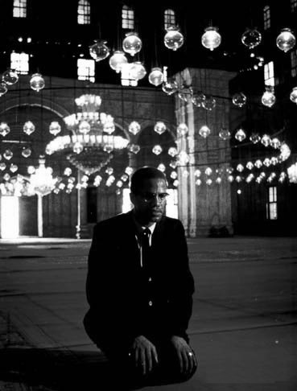
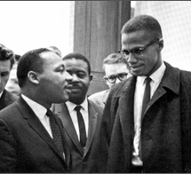
RELIGION: Religious Symbols and ghostly figures of pilgrimage and mosque arch shapes

Slide 9
Malcolm (Waves 12)

Slide 10
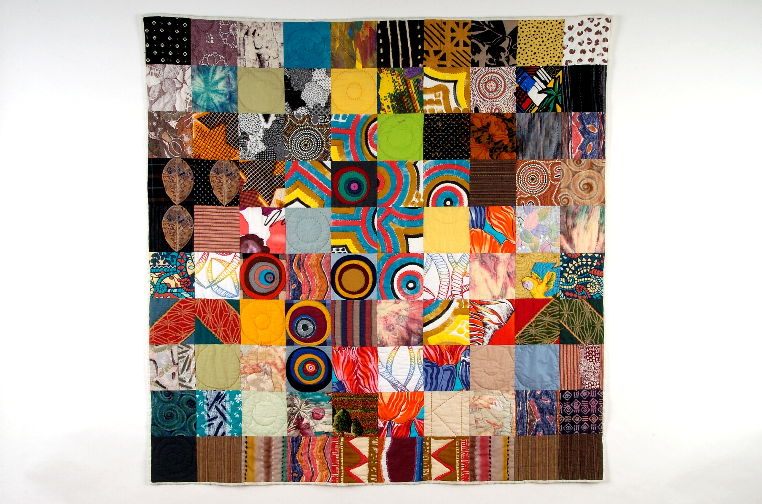
AUSTRALIA 4

Slide 11

INDIGENOUS PEOPLE: COMPARATIVE LAW: INTERNATIONAL HUMAN RIGHTS
Top squares – black dominant (indigenous Australians).
Center – yellow and circle dominant (Sun).
Bottom – Red dominant with earth tones (land of Australia)
Australian Aboriginal Flag

Slide 13
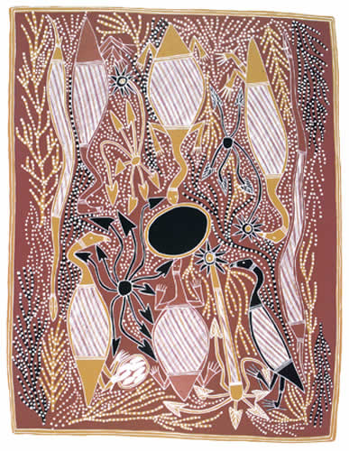
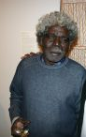
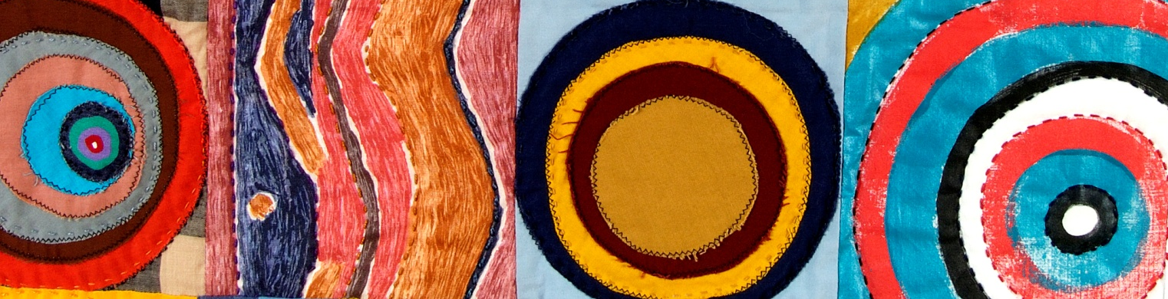
“The Sacred Waterhole Dimirr Warlmun” by John BulunBulun
INDIGENOUS PEOPLE AND INTELLECTUAL PROPERTY: Squares from commercially sold dot painting fabric from central Australian desert peoples. Hand painted dot squares.

Slide 14
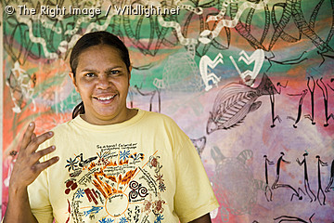
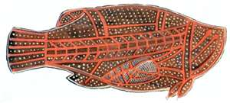
INTELLECTUAL PROPERTY: Squares purchased from aboriginal artist Mandy Muir and commercial leaf fabric in north Australian exoskeleton style

Slide 15
AUSTRALIA 4

Slide 16
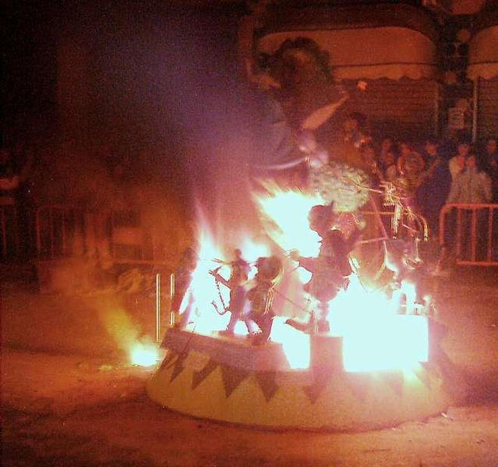
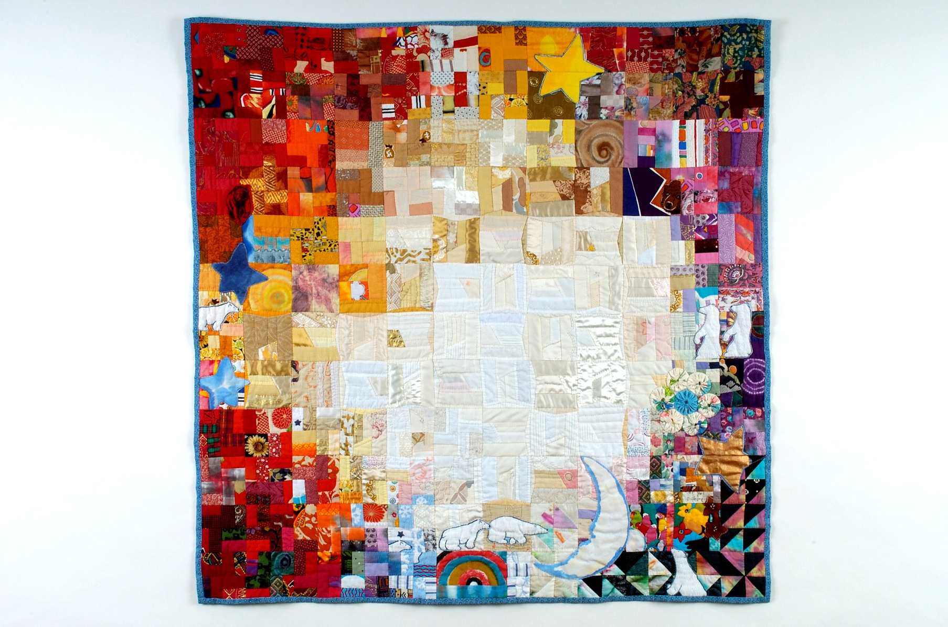
POLAR BEARS AT LAS FALLAS

Slide 17
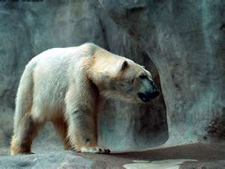
ENVIRONMENTAL LAW: The Polar Bear has become a symbol for threat to habitat from global warming. Polar Bear motif Patricia designed in Escher class at Design Symposium in San Diego

Slide 20
Polar Bear Applique moving under the moon amid tropical birds and flowers

Slide 21
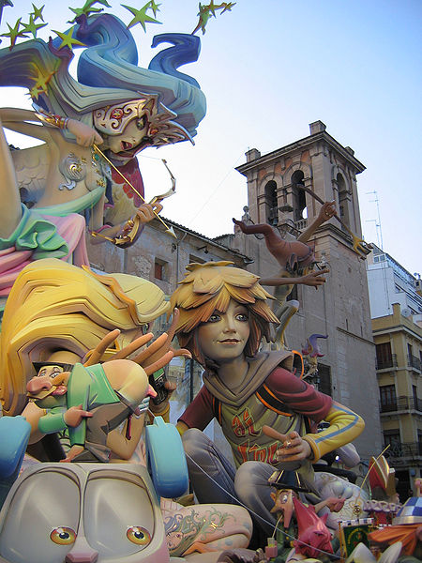
ENVIRONMENTAL LAW: Festival of Las Fallas in Valencia Spain as a representation of Global Warming. Red flame blocks to upper left, White fire blocks in center lower right; dark figure squares bottom right and dark sky squares upper right

Slide 22
POLAR BEARS AT LAS FALLAS

Slide 23
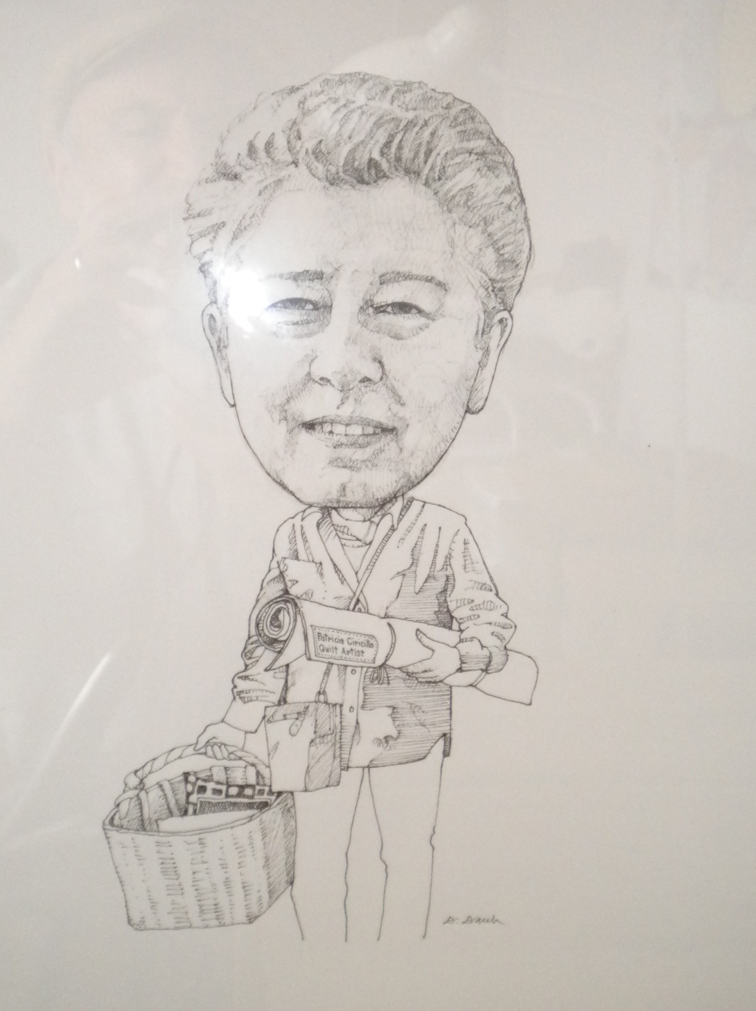
Drawing by Dennis Daub.

